Slide 1
2048 – A RL Approach
By John Lee

Slide 2
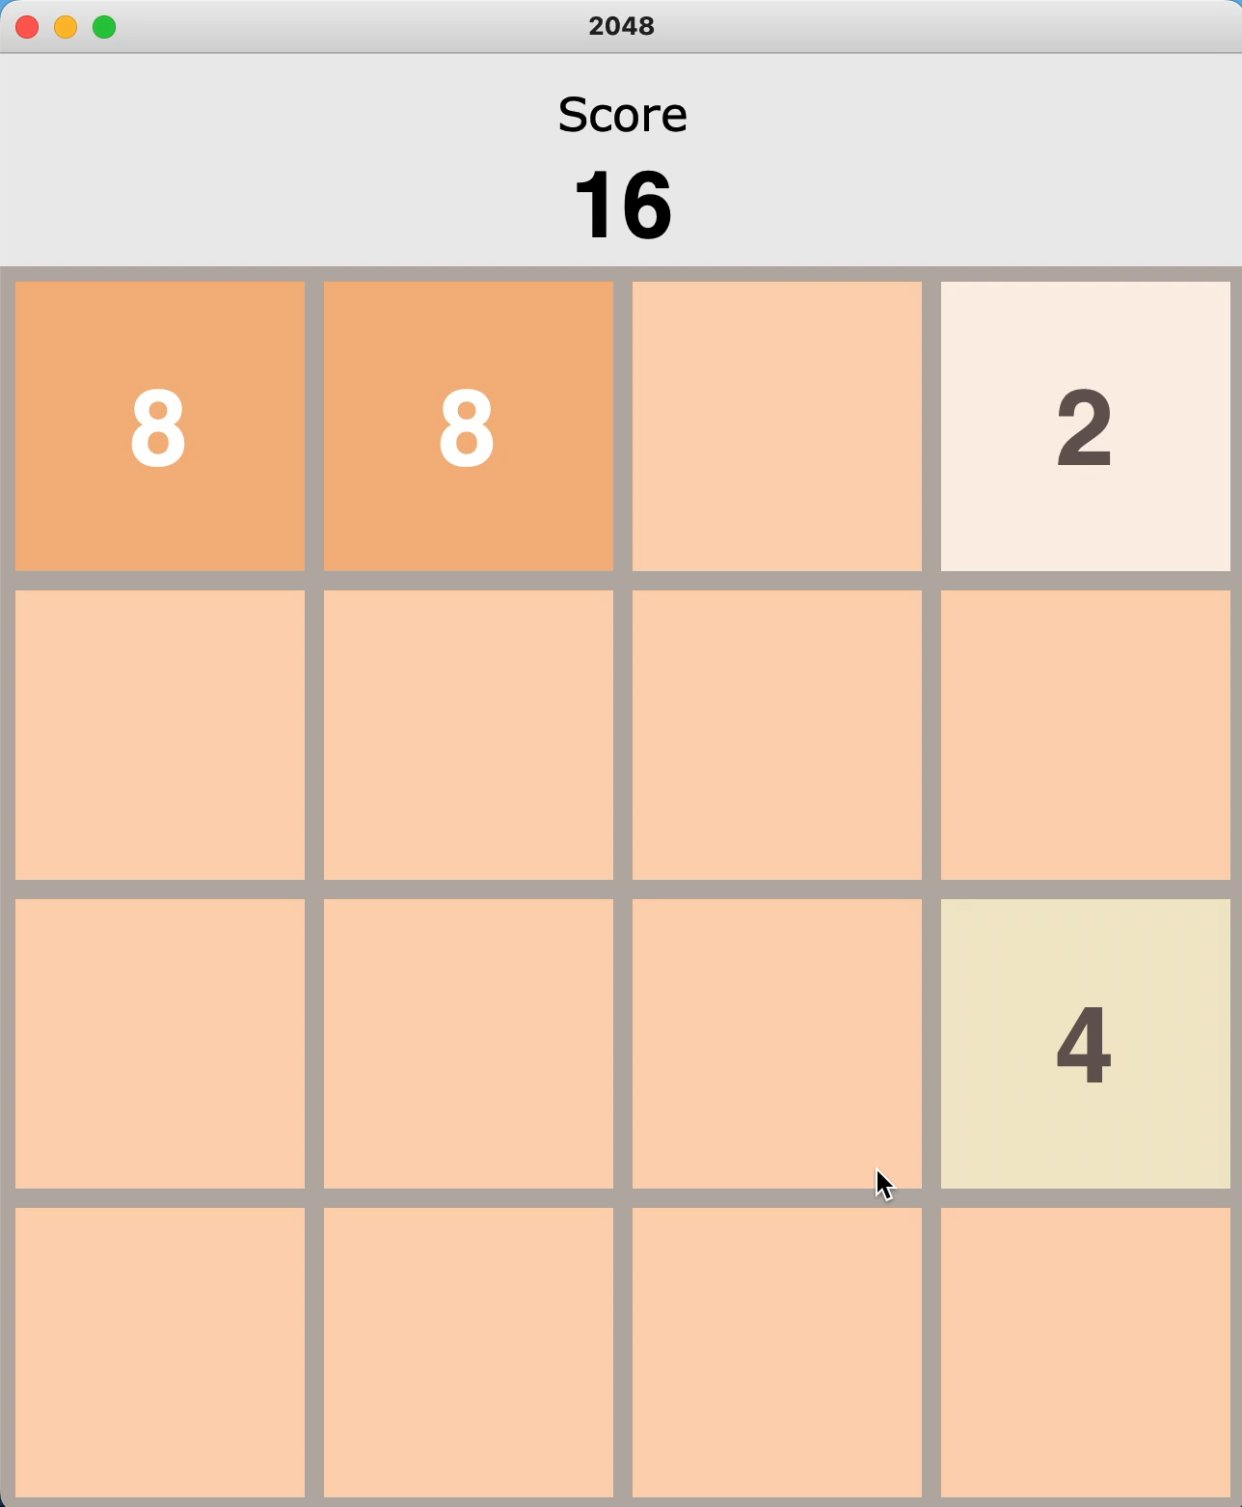
What is 2048?
Simple Game on 4x4 board
Goal - Combine blocks in multiple of 2 until 2048
Moves
Left, Right, Up, Down
Score
The total value of the blocks you combine
Loss
No more valid moves

Slide 3
Manual Playing is BORING!!!

Slide 4
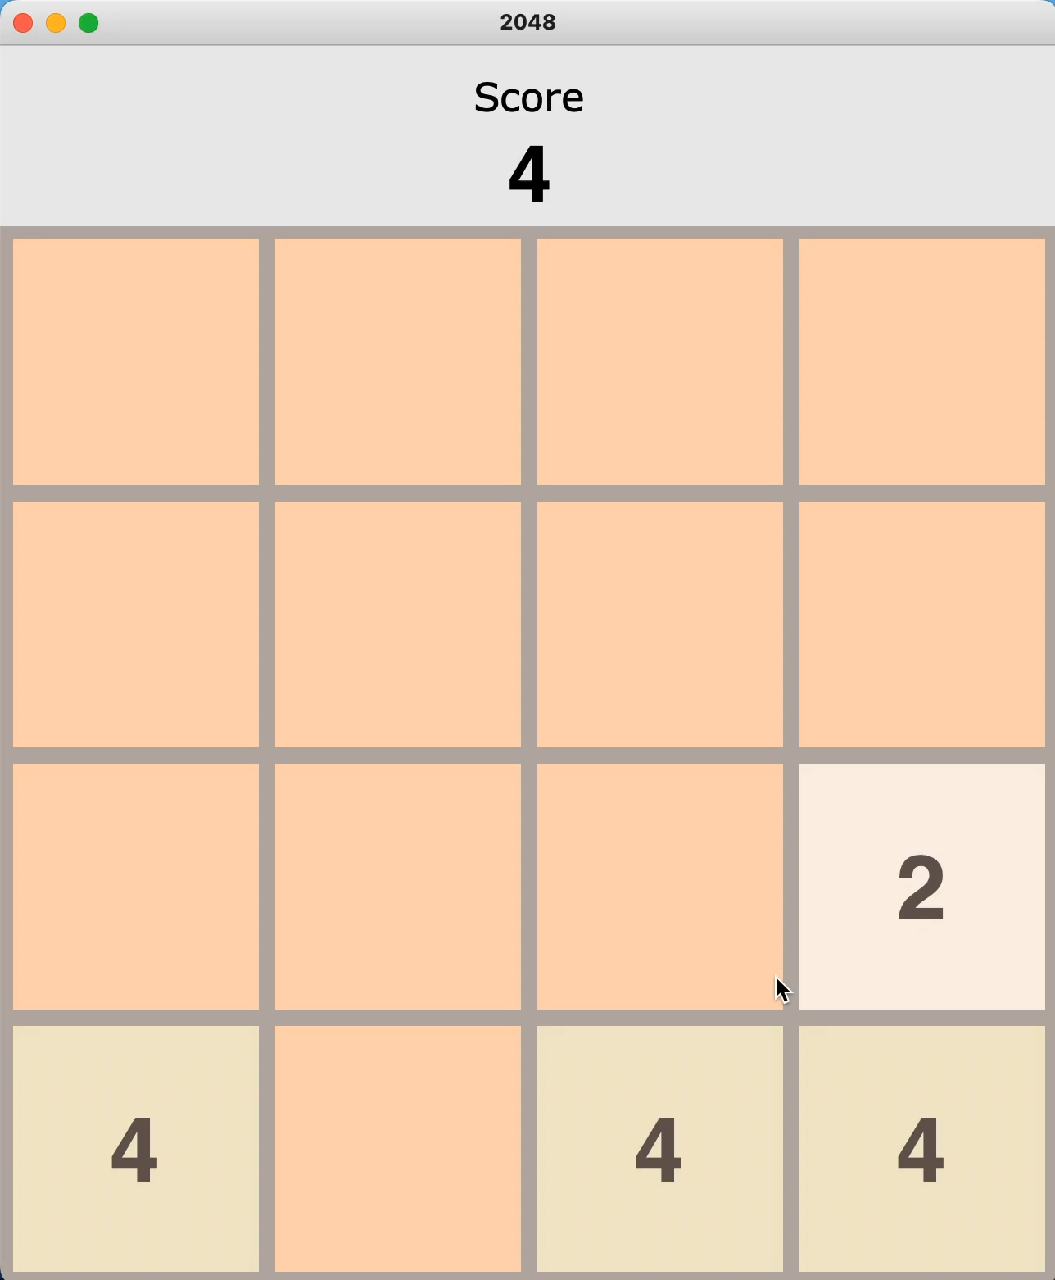
Why?
People have determined that keeping your largest number in a corner is the optimal strategy.
Games get repetitive, yet frustrating.
You don’t learn anything playing the game over and over!

Slide 5
Solution?
Let’s have a Reinforcement learning BOT play it for us!

Slide 6
RL Problem!
Actions
Left, Up, Right, Down
Reward
Score of move
Ex. stacking 2 128 blocks gives a score of 128
Invalid moves = -512
Goal
Achieve as high of a score as possible

Slide 7
Attempt 1 – Deep Q Learning
Failure - LOL

Slide 8
Network
Multi-Layer Perceptron
Input Layer
16 neurons – for a flattened board of 4x4
ReLU activation
3 Hidden Layers
1024, 512, 256 neurons
ReLU activation
Output Layer
4 neurons – One for each possible action
Linear activation
Model captures the expected score of a particular action from a particular state

Slide 9
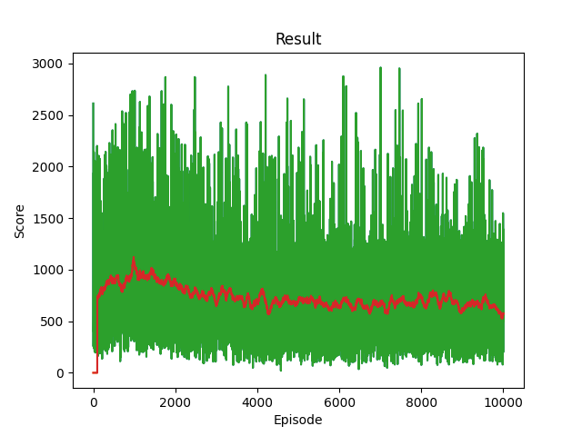
Training
Optimize using ADAM
Huber Loss
Update the network after each action
10000 episodes
Training sucks!!! The model does not learn
Likely due to the state space being too large, and updating the network for each state happens too slowly

Slide 10
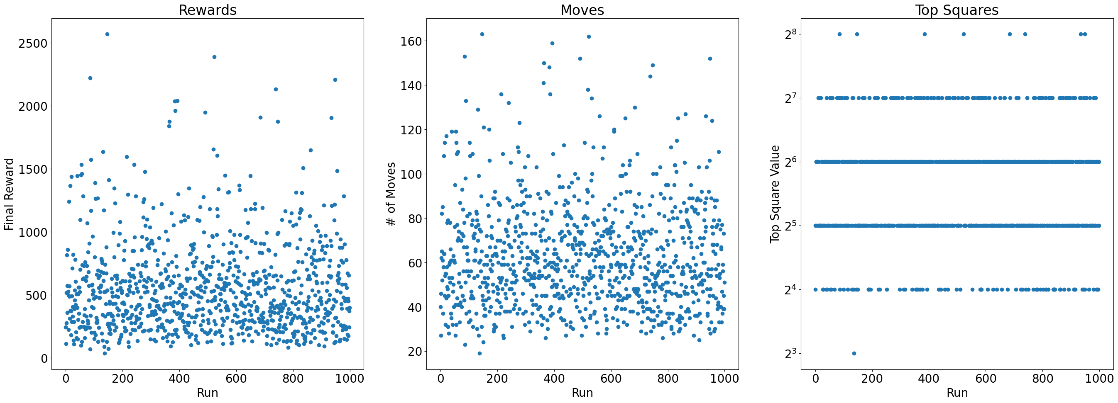
Evaluation
1000 simulations of real game
Mean Score – 559
Top Square - 256

Slide 11
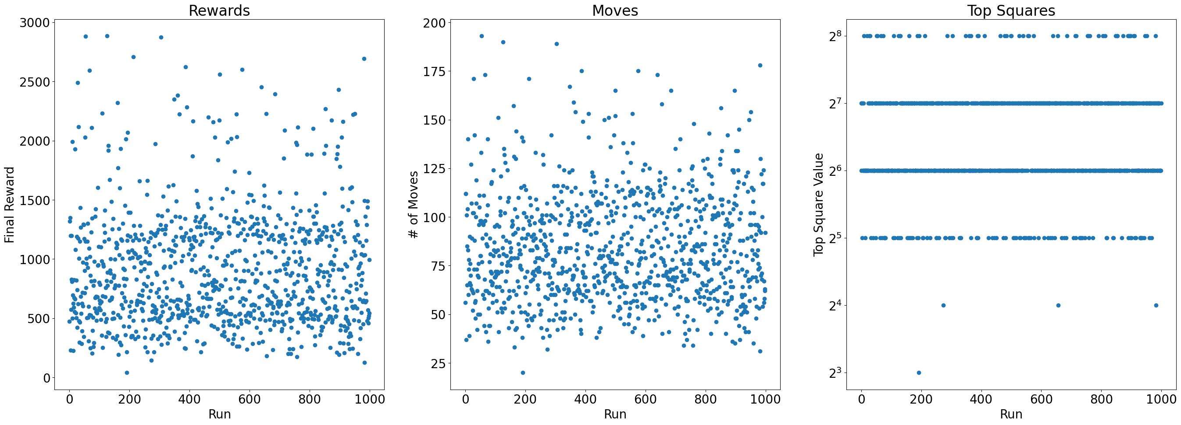
Evaluation – Worse than RANDOM!!!
1000 simulations of random move game
Mean Score – 910
Top Square - 256

Slide 12
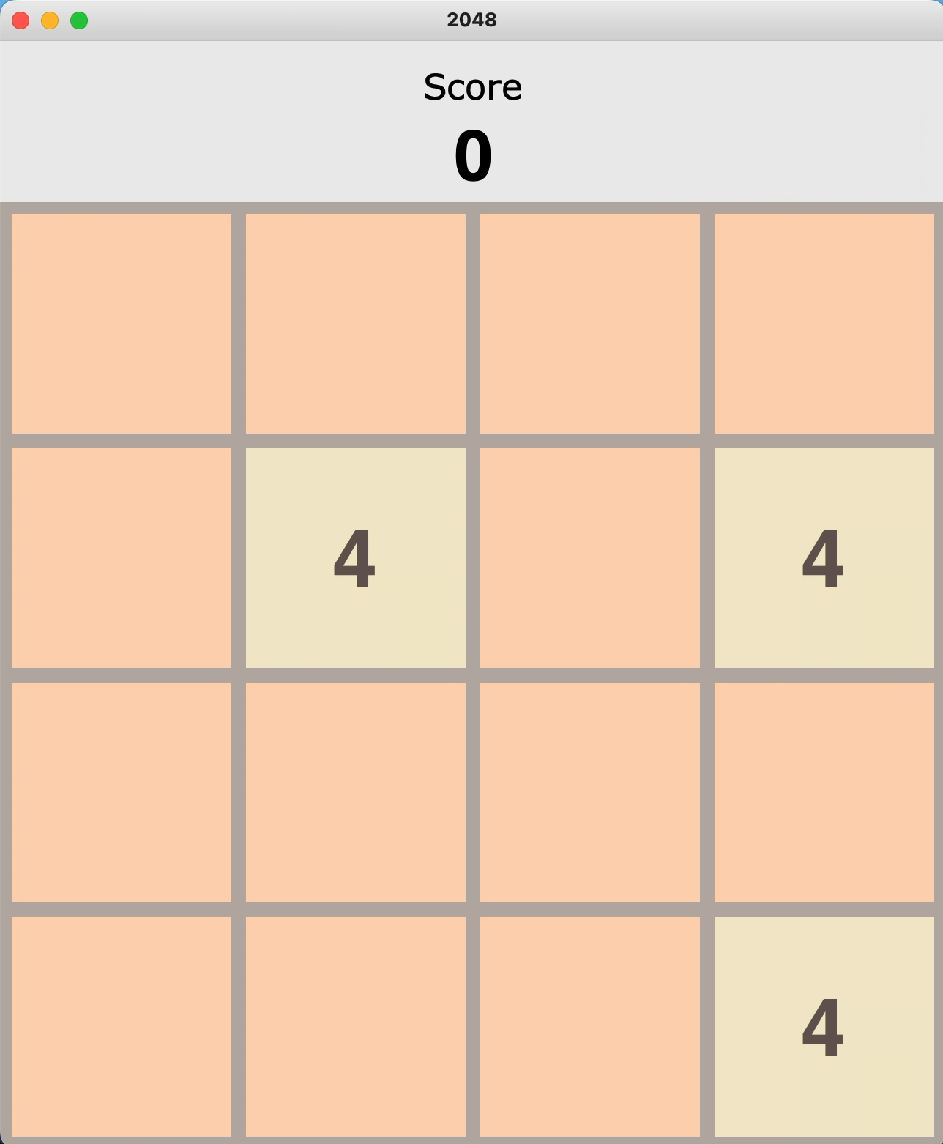
Bot Playing Game
Sucks but amusing to watch

Slide 13
Attempt 2 – Deep Q Learning w/ Action Search
Success!

Slide 14
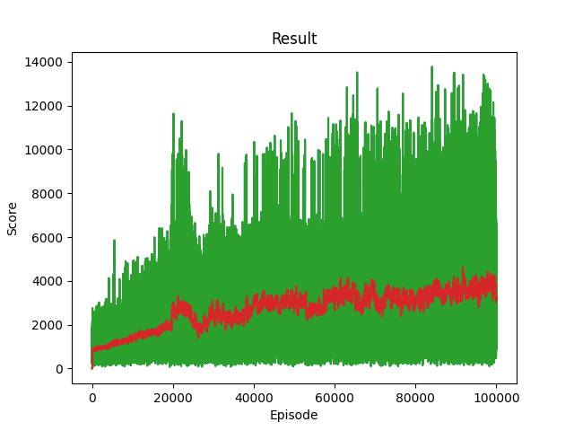
Training
Use the same network
Model should be complex enough
Changes from attempt 1
Training Method
Rather than update the model after taking a single ”best” action
Take a pseudo-action, compute the reward and update the score for EVERY single action from a single state
Attempts to solve convergence problem in network
Run for 100,000 episodes
Successful learning! Could even train longer.

Slide 15
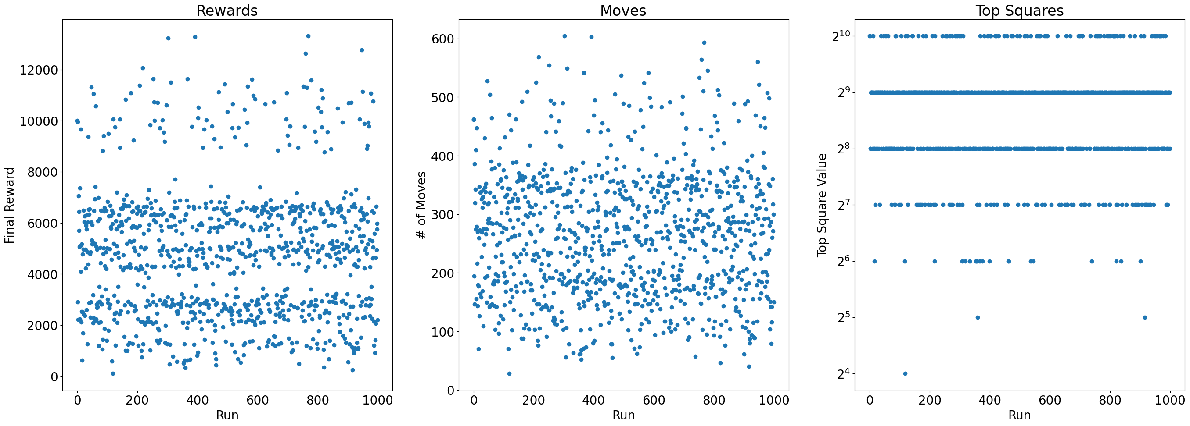
Evaluation
1000 simulations of real game
Mean Score – 4786
Top Square – 1024

Slide 16
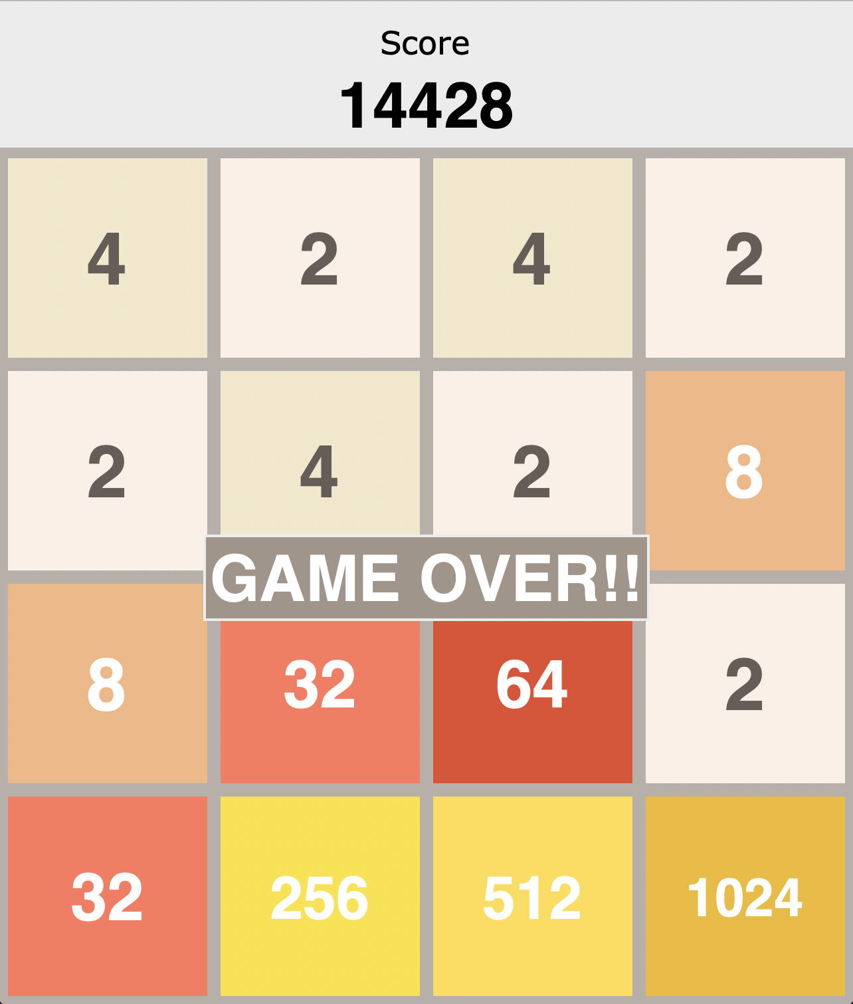
Comparison
Much better than Random!
High score close to my best human performance (right)!
Still room to improve, whereas I am hard-stuck

Slide 17
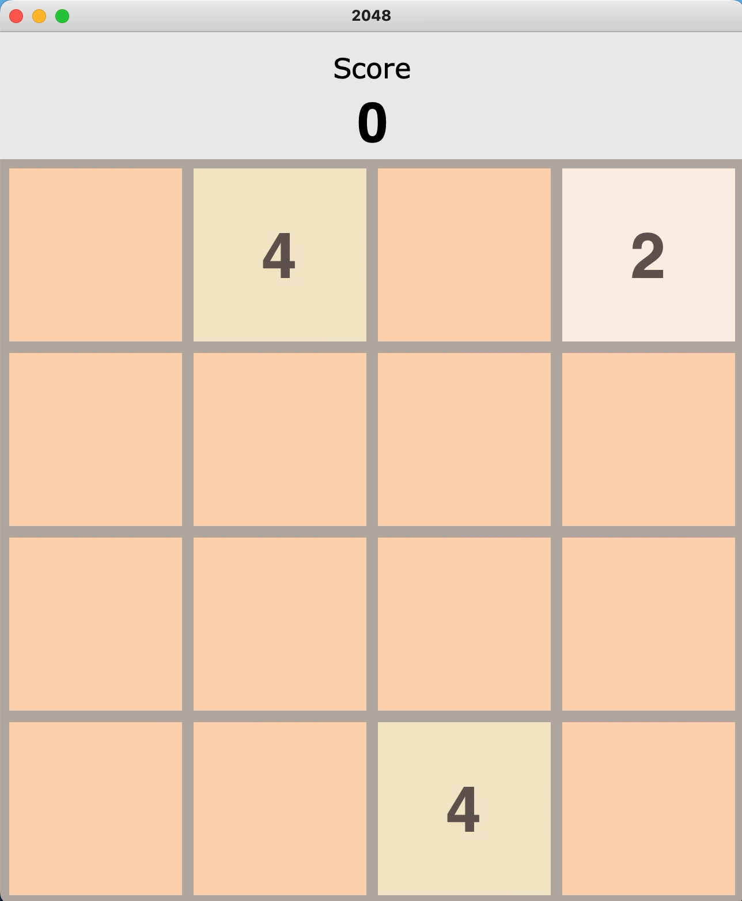
Bot Playing Game – Better this time
Actually cool
Learns to keep higher numbers in the corner, meaning it learned optimal gameplay!
Fast!!!

Slide 18
Future Work
Could do a Monte Carlo Tree search, with depth 1 or 2.
Current method is similar to depth 1, but without the probabilistic method
Train even LONGER
Use a different network???

Slide 19
Thank You!

